Slide 1
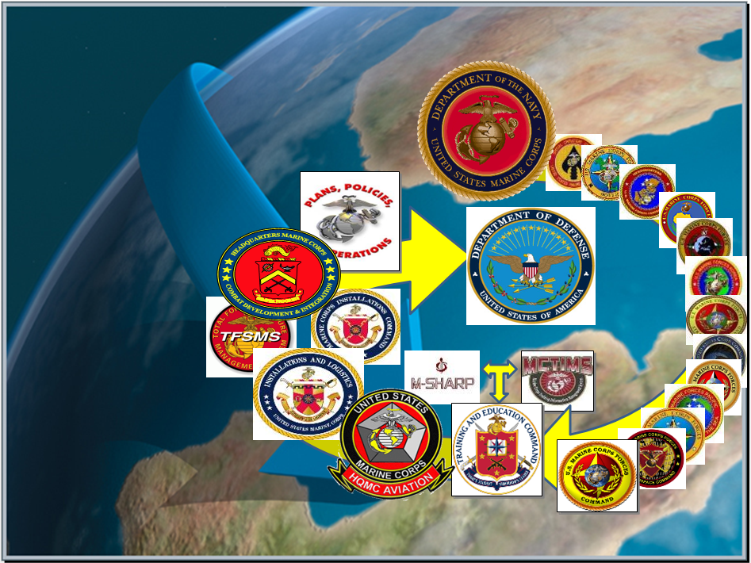
Marine Corps Task List
Mission Essential Task List
MCTL / MET / METL
Life Cycle Development
MAR 2024
MCTL Branch
Total Force Structure Division
HQMC, CD&I, CDD

Slide 2
Overview
MCTL Branch Mission = Life Cycle Authoritative “Data Driven” Deliverables
Mission Planning, Requirements, MET-based Capabilities, Force Readiness
METs within the DoD Planning, Programming, Budgeting & Execution (PPBE) Process
MCT-to-MET-to Joint Staff MET Alignments
MCTL: The Dictionary of Current Capabilities; MET Building Blocks
CD&I’s Policies and Processes Alignments = MCT-to-MET/METL Workshop Process Deliverables:
  Mission Statement; MET standards Development (“Baseline/Advanced” Capability Statements; Manning/Training/Equipment and Outputs)
MET-to-Training and T&R Manual Alignments, MCT Change Recommendations
MET Standards Development Examples, Authoritative Data Source (ADS) System Repositories, Product Staffing, Approvals, Validation
CD&I METL Governance Board Unit Checklist, Support to Global Force Management (GFM) Process, Institutional Readiness WG (IRWG) and Quarterly Readiness Brief to CMC (QRB)
MCTL Branch MET/METL Development Process Future Coordination Goal
MCTL/MET/METL Life Cycle Products Info and POCs and Detailed Backups

Slide 3
CD&I / CDD
Total Force Structure Division
MCTL Branch Mission
DIRLAUTH per MCO 3500.26B (MCTL)
For development of defined content of capabilities/actions/activities expressed as Marine Corps Tasks (MCTs) resident within the Marine Corps Task List (MCTL) and Service Authoritative Database Source (ADS) System MCTIMS interfacing data to DRRS.
For ensuring MCTs are doctrine-based, provide accurate definitions, and represent all elements of the MAGTF.
DIRLAUTH per MCO 3500.110 (METL Development)
Codifies Mission-Essential Task/Task List (MET/METL) and associated man/train/equip standards and outputs data development process.
Data represents “as-is” Current Force capabilities; used to develop “to-be” Future Force capabilities.
MET development includes criteria and scale to produce standards to achieve capability outputs assessed for mission support required for MET-based readiness reporting.

Slide 4

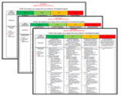





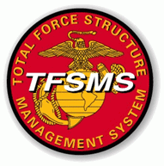

MCT / MET / METL Integrated Life Cycle
CURRENT Force Capability Requirements: Core/OPLAN/Assigned Mission
FUTURE Capabilities: Future Force Design
Current Deployable and Ready Mission Forces METs/METLs
USMC READINESS
DRRS Enterprise
MCTL “Tasks” = METs / METLs (MCTIMS)
Structure = Mission Statement/T/O&E (TFSMS)
Training = T&R Manual (MCTIMS)
Baseline/Advanced Performance Standards
Man / Train / Equip / Output
USMC Missions
Requirements
Capability Development Structure & Resources
Education
POIs
Training
RFFs / RFCs – Force Sourcing of Established USMC Current Capabilities
Mission Readiness Assessments
“Ready Force”
Mission Planning + Requirements + Capabilities + Resources =
Sourcing the Force and Reporting FMF Readiness in DRRS

Slide 5
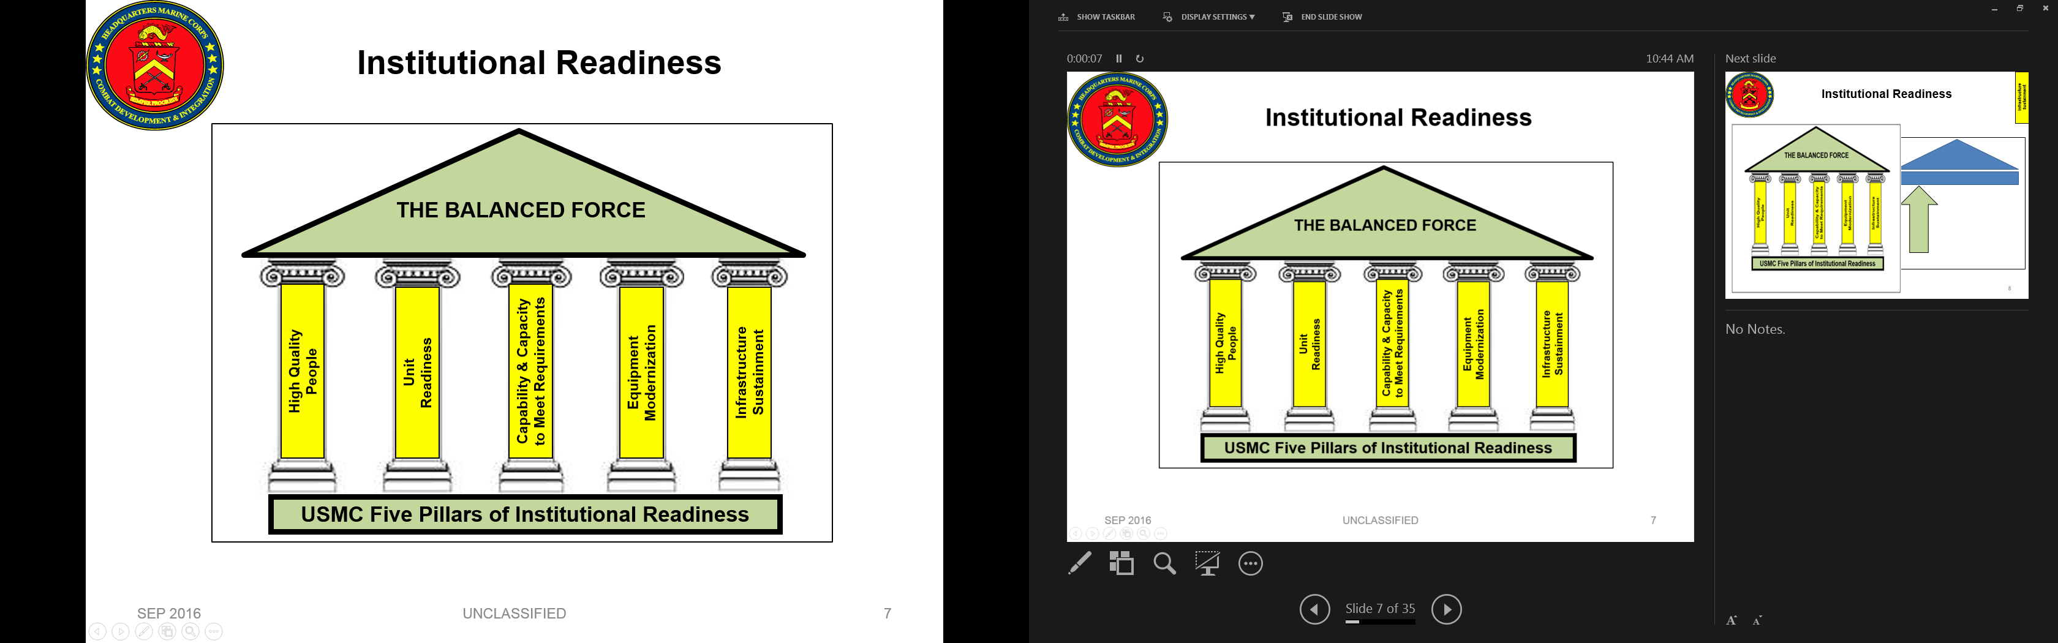
MCTs/METs/METLs, Capability Development Processes and PPBE**
NSS
NDS
39th CMC CPG
Operating & Functional Concepts
CURRENT METs/METLs
FUTURE METs/METLs
DPG
NMS
Force Development & Integration Strategic Plan
Approved P&R Assessment
QDR
GOALS:
--Ensure “CURRENT” capabilities (“METS”), supports “FUTURE” concepts and capabilities planning ensuring requirements development cycle produces feasible man/train/equip resources to achieve mission.
--Identify capability deltas, gaps and identify solutions via DOTMLPF process and Future Force capability development initiatives to improve FMF METs and associated standards, or, that aids in developing “Future” MCTs/METs.
Force Design Annual Report (FDAP)
P&R
(PA&E)
FY-28+
PB-24
Guidance
CD&I / CDD, OAD and MCWL
Assessment
End of FY
Force Design
METs / METLs
DRRS-MC
MCCL
MAGTF Wargames
OPFOR / SE
Execution
MCGL
POM-27
CD&I / CDD
PB-24
MCSDD
Planning
Front End Assessment
MCCIP
CD&I / CDD (TFSD)
CD&I “PLAN”
Program Reviews
Budgeting
Programming
= MROC
POM
POM-26
= Document
FY-25
P&R
MARCORSYSCOM
= Transition
P&R
Inside=Output;Outside=Input
**“Accelerate and streamline our modernization…Simultaneously, our ability to rapidly respond to Global crises must be maintained.”
Gen.Eric M. Smith, 39th CMC (2023)

Slide 6
MCT / MET Joint Staff Alignments
DRRS-Strategic (DoD / JS / OSD / Chairman’s Readiness System)
Combatant Commands & COCOM JMETs / JMETL
Aligns/Links to Service Components METs/METLs
Supported
CCMD/CCDR
USMC METL
MARFOR
OP 5.3.9 Prepare Supporting Campaign or Major Operation Plans
MEF/MEU/MEB
MCT 1.3.1 Conduct Maneuver
“Tasks”/ METs align
Top Down / Bottom Up
Marine Division
MCT 1.6.4 Conduct Defensive Ops
Infantry Regt HQ
MCT 5.7.4 Plan and Direct Defensive Ops
Infantry BN
(Subordinates)
MCT 1.10 Conduct Crisis Response
MCT 1.7 Support Maneuver Through the Provision of Training Areas
MCT 4.6.6 Community Services
MCT 4.1 Conduct Supply Operations
MCT 4.3 Conduct Transportation Operations
MCT 4.6 Provide Services (Nonmaterial & Support Activities)
MCT 4.6.3 Provide Airfield Operation Services
MCT 4.9 Provide Base and Station Facilities and Related Infrastructure
MCT 6 Protect the Force
MCICOM
--MCIWest (I MEF)
--MCIEast (II MEF)
--MCIPac (III MEF)
--MCI-Regional
Installations / Bases / Stations METLs provide Supporting Establishment / Infrastructure and Support Programs

Slide 7

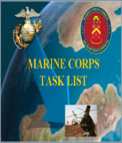
MCTL Supports Current Capability
MET/METL Development
MCTL: “Dictionary” of current USMC activities/actions/capabilities defined as “Tasks” that an organization must perform to accomplish a mission.
  MCT’s are used by COI / SE as “Building Blocks” for METs/METLs
MCTs are Organized by the Six (6) Warfighting Functions (WFF):
  Maneuver
  Intelligence
  Fires
  Logistics
  Command and Control
  Force Protection
  Information*
Contains Task Title, Task Definition, Doctrinal Ref and Suggested Measures of Performance
*NEW Warfighting Function
USMC TASKS:
MCT 1.6.1 Conduct Offensive Ops
MCT 1.6.4 Conduct Defensive Ops
MCT 1.10 Conduct Crisis Response
MCT 1.12 Conduct Expeditionary Ops
MCT 1.13.2 Conduct NEO
MCT 1.15.1.2 Facilitate Foreign HA
1. MCT 1.6.1 Conduct Offensive Ops
MCT 1.6.4 Conduct Defensive Ops
MCT 1.10 Conduct Crisis Response
MCT 1.12 Conduct Expeditionary Ops
MCT 1.13.2 Conduct NEO**
MCT 1.15.1.2 Facilitate Foreign HA**
**Not deemed CORE by Community but could be CORE+ for
Assigned Mission / OPLAN METL
Official Tri-Service Directive
OPNAVINST 3500.38C
MCO 3500.26B
USCG COMDTINST 3500.1C
Revised 16 Aug 2018
EX: INFANTRY CORE METL
TASK (MET)
TASK (MET)
TASK (MET)
1
2
3
TASK (MET)
TASK (MET)
TASK (MET)
4
5
6
FMF/Units DRRS Report – 30 Day Interval
SE/Installations DRRS Report - Quarterly

Slide 8
MCTL – What is a Marine Corps Task?
  “Tasks” describe capabilities / actions / activities
  a Unit or Organization must perform to accomplish the mission
        1. Maneuver
        2. Intelligence
        3. Fires
        4. Logistics
        5. Command and Control
        6. Force Protection
        7. Information
Contains Task Title, Task Definition, Doctrinal References and Suggested Measures
EXAMPLE Marine Corps Task
Task Title: MCT 1.12.1 Conduct Amphibious Operations
Definition: To conduct a military operation launched from the sea by an amphibious force, embarked in ships or craft with the primary purpose of introducing a landing force ashore to accomplish the assigned mission. Types of amphibious operations include assaults, withdrawals, demonstrations, raids, and other amphibious operations in a permissive, uncertain, or hostile environment.
Doctrinal References: (JP 1-02, 3-02, MCDP 1-0, 3, MCWP 3-33.7, 4-11.8, MCRP 3-33.7A, MCO 3104.1)
Suggested/EXAMPLE Measures:
M1 Percent Of qualified and deployable MOS Marines available to conduct Amphibious Operations.
M2 Percent Of Mission Essential Equipment (MEE) supply on hand and Mission Ready.
M3 Y/N Able to conduct amphibious ops at MEB level, transitioning MAGTF capabilities ashore from amphib shipping
M4 Y/N Regimental HQ capable of executing C2 throughout all phases of the amphibious operation.
Designed Capabilities of a USMC Unit
or
Functional Support Capabilities of an Installation / Base / Station
Six Warfighting Functions
Notes:
8

Slide 9
MCTs Become Unit METs
MCT
MCT
MCT
MCT
MCT
MCT
MCTL: Common reference guide used by USMC commanders, mission planners and unit trainers.
Units derive their “tasks” from MCTL per requirement to report their capability readiness via the MET-based construct within SECDEF Defense Readiness Reporting System (DRRS).
MCTL “Essential/Critical” MCTs for mission accomplishment become Mission Essential Tasks (METs) that align to the COI’s T&R Manual.
Core METs
  Critical, discrete, externally-focused activities that enable execution of the organizational mission; tasks for which standing organizations were designed; standardized for each unit type
Core Plus METs
  Have lower probability of execution; theater specific; NOT included in unit readiness assessments; Units may elect to include Core Plus tasks in their METLs and associated training plans
Assigned/OPLAN METs
  Developed and assessed when 25% or more of a unit deploys or prepares to deploy ISO a Named Operation; Based on Core METs, Core Plus METs, Mission templates, and deployment guidance
Standards: Baseline/Advanced Capability Statements, Personnel, Equipment, Training/E-coded Events/Exercises, Outputs.
Baseline/Advanced
Readiness Standards
Personnel
Training
Equipment
Exercises
Outputs
Subordinate/Supporting Units
Unit METL
Core Mission
Assigned Mission
Mission Statement
MET
MET
MET
MET
MET
MET
DRRS

Slide 10

CD&I’s Policy Alignments:
MCTL (MCO 3500.26) and MET / METL Development (MCO 3500.110)
Total Force Structure Process (MCO 5311.1E)
MET/METL Development: Supports mission planning, training and T&R Manual review and development processes. Coordinated process involving CD&I, Principal Advisor/Stakeholder, PP&O and TECOM.
Aligns to…
Mission Statement & T/O&E Validation: CD&I’s Total Force Structure process where Unit/COI defined organizational capability and mission intent is expressed via Mission Statement within TFSMS. Unit METs/METL aligns to defined Mission Statement, available personnel and equipment.
Aligns to…
TECOM’s T&R Manual & TMT Reviews: TECOM training processes that identifies MET-based training component requirements, necessary event chaining and exercise synchronizations, POI and curriculum refinement and development.
Supports…
PP&O’s GFM Processes and FMF / SE Readiness Reporting Requirements ISO DOD/Chairman’s Defense Readiness Reporting System (DRRS).
Plans, Policies,
& Operations

Slide 11

MET / METL Review Workshops Process
(MCO 3500.110**)
**2023-2024 MCO Revision: Modifies 2011 MCO language to address changing roles/responsibilities, required METL development support, and evolving training and readiness reporting advancements.
Policy validating integration between CD&I, TECOM, Stakeholder and FMF community to review/revise/recommend METs and standards to satisfy mission requirements.
MSG via NIPR DON-ETMS2 and/or TEAMS invite announces review requirements:
Mission Statement: Ensure organizational capability and mission intent can be met.
(Be prepared to submit update recommendations if needed.)
Marine Corps Tasks (MCTs): Do defined actions/activities/capabilities continue to satisfy the organizational mission intent and requirement?
(Be prepared to make MCT refinements/modifications if required.)
T/O&E: Personnel / Equipment data, resident within TFSMS, aligns to METs/METL.
(*T/O&E discrepancies are facilitated via TOECR process coordinated with COI Principal Advisor and CD&I Total Force Structure Division)
T&R Manual: Determine training components/standards, training events.
(Be prepared to make NEW training requirement recommendations.)
Record of Proceedings (ROP): Captures COI AO attendance and recommendations
Plans, Policies,
& Operations

Slide 12
MCT / MET / METL Development
Physical or Virtual MET / METL Review Workshop Deliverables – Mission Statements
Mission Statements define capabilities (core competencies or operational requirements) for the Marine Corps IAW MCO 5311.1E Total Force Structure Process.
Mission Statements describe the organization, mission and tasks, concepts of organization and employment, administrative and logistics capabilities, and command and signal.
Review current unit Mission Statement to ensure alignment to chosen Core METs, or recommend revision for updating.
Mission Statement revision requires completion of the specific package of documents for presentation/approval by the community Principal Advisor, and submission to CD&I Total Force Structure Division for approval by DC CD&I.
Principal Advisors are responsible for creation, review, modification, formal staffing and General Officer endorsement of proposed final copy.
  Ensures every unit identified by a UIC has a current Mission Statement.
  Ensures review of Mission Statements is conducted every three (3) years.
  Ensures community METs are aligned with their appropriate unit’s Mission Statement.
Mission Statement updates have three (3) months from date developed/revised unit METs are incorporated and published within MCTIMS.
12

Slide 13
MCT / MET / METL Development
Physical or Virtual MET / METL Review Workshop Deliverables - Mission Statement
Units without valid current Mission Statements run the risk of not having submitted TOECR’s considered. Mission Statements are required to validate requested changes.
The community’s Principal Advisor shall electronically staff the endorsed unsigned Mission Statements to DC CD&I (TFSD) for final administrative review and submission to CMC (DC CD&I) for final approval.
MCO 5311.1E Total Force Structure Process, Appendix B, provides example of the Mission Statement Format/package necessary to facilitate change. Format contains:
  Header (i.e., Department of the Navy, HQ USMC, 3300 Russell Rd, Quantico VA 22134)
  UIC or Multiple UICs/Organization Name (Unit Identification Code-M21810 2nd Assault Amphibian BN)
  Promulgation Statement (Briefly outline the organization and content of the continuity of operations plan and describe what it is, who it affects, and the circumstances under which it should be executed.)
  Organization (i.e., HQ & Service Co.; A Company; Engineer Support Co.)
  Mission/Tasks (i.e., MCT 1.1.2 Provide Task-Organized Forces; MCT 1.6.1 Conduct Offensive Operations; etc.)
  Concept of Organization (Briefly explain the unit’s organization and reporting heirarchy. (Who the unit reports to)
  Concept of Employment (i.e., 6 warfighting functions)
  Admin Capabilities (i.e., How the unit’s administration is carried out and to what extent)
  Logistics Capabilities (i.e., 7 functions of logistics)
  Command and Signal (Briefly explain who the commander of this unit reports to and capability it provides).
  Supersession (Ex: This Mission Statement supersedes the previous Mission Statement and is effective upon receipt)
13

Slide 14
MCT / MET / METL Development
Physical or Virtual MET / METL Review Workshop Deliverables - Standards
Determine, or revise, current Baseline and Advanced capability statements
Develop MET standards:
  Identify critical MOSs necessary to execute the METs
  Identify mission-essential equipment (MEE) necessary to execute the METs
  Develop MET training event standards aligned with T&R manuals
Capture C-IED and CBRN training requirements into Baseline standards for at least one MET of unit METL; Capture live Amphib exercise in Advanced standards for at least one MET
Identify Units of Employment (UE)* standards (if applicable to the organization)
  *UE: Level at which a unit generates forces for deployment, normally the building blocks of standard task organization.
Identify supporting/subordinate unit necessary to achieve defined MET capability.
Determine staffing requirements, internal and external, of developed deliverables.
14

Slide 15
MCT/MET/METL & T&R Development Process
Adapting to Future Force Design and Modernization
MARADMIN 414/23 – FY24 Schedule of MET/METL, T&R Manual & TMT Reviews
“COIs will develop/validate METs and aligned T&R training events ISO prioritized service capabilities.”
Established “Current” MCT / MET / METL / Training Development Process:
A unit’s mission requirement; What capabilities can the unit provide NOW?
What MET-aligned e-coded training events/exercises are conducted NOW?
Adapted “Future” MCT / MET / METL / Training Development Process:
DRAFT MCTs/METs developed from “concepts”:
  Requires Service validation to quantify TTPs and curriculum development.
  Requires defined actions/activities/capabilities derived from available doctrine (i.e., Joint, USMC or other Service).
  May NOT have existing/aligned curriculum, POI, training standards, or T&R events.
  Requires experimentation and training exercises IOT determine MET-to-training feasibility.
  Are NOT officially published/available within MCTL / MCTIMS / DRRS.
“Future METs”, will be incorporated within MCTL as “DRAFT, or, T-MCTs” for use in MCTIMS training modules to aid in training experimentation. Once approved, can be used as readiness reportable METs for the unit and aligned to the T&R Manual.

Slide 16
NEW or Revised MCT Recommendations
REVISED MCT 3.2.3.1.2.1 Conduct Strike Strike operations damage or destroy an enemys objective or capability. Strike operations include both air interdiction and attack operations. Air interdiction is an air operation conducted to divert, disrupt, delay, or destroy the enemy’s military surface capabilities before it can be brought to bear effectively against friendly forces, or to otherwise achieve enemy objectives that are conducted at such distances from friendly forces that detailed integration of each air mission with the fire and movement of friendly forces is not required. Attack operations include offensive action by any part of the joint force in support of the Offensive Counterair (OCA) mission against targets which contribute to the enemys air and missile capabilities. JP 1, 0-2, 3-0, 3-01, 3-03, 3-09, 3-30, 3-31, MCWP 3-2, NDP 1, NWP 3 FORMER MCT TITLE/DEFINITION MCT 3.2.3.1.2.1 Conduct Air Interdiction Air interdiction operations destroy, neutralize, or delay the enemy's military potential. This type of operation is a response to a known target that is briefed in advance. Air interdiction is normally part of the JFC campaign.
Requires METL Review WG provide:
Described capability, actions, activities
Doctrinal support (USMC, Joint, Other Service)
Rationale of Task to meet HHQ guidance, mission statement and mission requirements
Ensure Task is aligned to necessary training and T&R Manual alignments or modifications.
Crosswalked. Does the MCT revision potentially affect another COI that may be also using it as a MET for their DRRS report?
  MEU OAG
NEW
MCT 1.12.8 Establish and Operate Expeditionary Advanced Bases
To seize or occupy, establish, operate, sustain, and disestablish one or more expeditionary sites in support of naval operations, to include, but not limited to, ports, airfields, FARPs, forward operating bases, and firing areas. This task may include reducing pockets of resistance, establishing security, and operating the site(s) until the site is disestablished or control is transferred to another organization.
JP 3-0, 3-10.1, 3-18, MCDP 1-0, MCDP 3; MCWP 3-2, 3-32
  AVN METL Review Feb 2019

Slide 17
MET Standards
  The combination of measures and criteria used to illustrate minimum acceptable proficiency required in task performance.
  FOCUS: Develop standards consistent with capability intent and desired outputs.
Resource:
Manpower (T/O) and Equipment (T/E) required to produce the outputs
Training:
  Each MET should have standards for two (2) levels of trained proficiencies:
        Baseline Capability: Level of readiness expected from a USMC tactical unit, normally sustained through unit Core training at home station and achieved without requiring a Deployment for Training, dedicated at-sea training, or external MAGTF support.
        Advanced Capability: Level of readiness required by specific units expected to perform a critical role in a mission or OPLAN. This level of readiness normally requires external MAGTF support, ship-to-shore movement, or a Service-level or Joint training exercise. Units designated for training to this level are normally selected through the force synchronization process.
  METs align to COI T&R Manuals, individual/unit “E”-coded training events, and exercises/certifications necessary or required to accomplish proficiencies, produce desired outputs and provide trained capability assessments.
Subordinate/Supporting Unit:
Tasks performed by other units that are required to produce the outputs; Required for intermediate level commands

Slide 18
MCT / MET / METL Development
MET Baseline / Advanced Capability Statements
Per CJCSI 3401.02 Force Readiness Reporting
“Qualified Yes”: Unit can accomplish all or most tasks to standard under most conditions. Specific standards and conditions that cannot be met, as well as the shortfalls or issues impacts the unit’s inability to accomplish the task. Must be clearly detailed in MET assessment.
“Yes”: Unit can accomplish the task to established standards and conditions. The assessment should reflect demonstrated performance in training or operations.
  Challenge: What is “most”?
  Solution: USMC re-defined the assessment process to distinguish between baseline standards (equivalent to “most”) and advanced standards (equivalent to “all” established standards).
USMC DRRS
“Qualified Yes” = Baseline readiness: Level of readiness expected from a USMC tactical unit, normally sustained through unit core training at home station and achieved without requiring a Deployment for Training, dedicated at-sea training, or external support
“Yes” = Advanced readiness: Level of readiness required by specific units expected to perform a critical role in a mission or OPLAN. This level of readiness normally requires external support, ship-to-shore movement, or a Service-level or Joint training exercise. Units designated for training to this level are normally selected through the force synchronization process.
Considerations for Baseline:
Sustainment at Home Station
Sustained across most of a unit’s lifecycle
No external MAGTF support required (evaluators or attachments)
No dedicated at-sea training required
Considerations for Advanced:
Peer threat
Adversary force used for training
Degraded/denied C2 environment
Training with attachments (external MAGTF support)
Deployment for training (Arctic, Jungle, etc.)
Ship-to-shore movement / at-sea training (naval platforms or connectors)
Joint or Naval context
Complex terrain
Accelerated response timelines
Evaluated exercise or MCCRE
Example: MCT 1.6.1 Conduct Offensive Operations (INF BN)
Baseline Capability: Company-level maneuver to seize maritime terrain objectives in support of naval operations.
Outputs: Coordinated company attacks, destroy an enemy force, of company strength, in prepared defensive positions. Exercise C2 and signature management across all expeditionary sites. Employ aviation-delivered fires.
Advanced Capability: Synchronized company-level maneuver to seize maritime terrain objectives defended by a peer adversary, in complex terrain, in a contested and/or degraded command and control environment.
Outputs: Integrate naval and joint fires into the scheme of maneuver. Synchronized company-level maneuver in complex terrain. Prepared positions / complex obstacles. Explosive hazard / improvised threat environment. Contested / C2D2 environment. Externally evaluated live exercise with naval force participation and a peer enemy force within the last 12 months.

Slide 19
MET Personnel (T/O) & Equipment (T/E)
Standards
Determine Personnel required to produce the required task outputs;
Link Personnel on the unit Table of Organization (T/O) to the tasks they support;
      Personnel Examples:
        >= 16 crews available and formed
        >= 80% Of entire T/O assigned billets filled with MOS-qualified, deployable personnel
        >= 30% of specific MOS 0621 (Transmission Systems Operators) available/deployable
Determine Equipment required to produce the required task outputs;
Link Equipment on the unit Table of Equipment (T/E) to the tasks they support;
      Equipment Examples:
      >= 80% of the BN T/E systems mission ready and available
      >= 4 stand-alone equipment T/E XXX kits ready and available
Personnel and Equipment metrics are used in DRRS to assess
the resources required to accomplish the task.

Slide 20
TFSMS
T/O-Critical MOS
T/E-Mission Essential Equipment (MEE)
T/O
Provides indicator of critical staffing shortfalls otherwise hidden in aggregate staffing %
Must select at least 3 MOS - Used in DRRS to calculate Critical MOS FIL
The total for the selected MOS should not exceed 75% of the T/O - Any particular MOS should not exceed 40% of T/O
T/E
Mission Essential Equipment (MEE): “Items of equipment whose availability is essential and indispensable for the execution of the METs of the unit in support of a Combatant Commander. Items designated as MEE are of such importance that they are subject to continuous monitoring.” [A subgroup of Principal End Item (PEI)]
MISSION ESSENTIAL TASKS (METS)
TFSMS T/O - Critical MOS | MCT 5.3.5.3.2 Conduct Airspace Surveillance | MCT 5.3.5.4.1 Conduct Positive Control | MCT 5.3.5.4.1.2 Provide ATC Tower Services | MCT 5.3.5.4.1.4 Provide Marine ATC MMT Services | MCT 5.3.5.4.1.5 Provide ATC Approach Services
TFSMS T/E – MEE TAMCN / NOMEN REF #

Slide 21
T/O EXAMPLE: 3rd MLR LCT Critical MOS
Current LCT Critical MOS List
Critical MOS | RETAIN |  | Critical MOS | RETAIN
0202 | Yes |  | 0631 | Yes
0203 | Yes |  | 0802 | Yes
0231 | No |  | 0811 | No
0241 | Yes |  | 0847 | Yes
0261 | Yes |  | 0848 | Yes
0302 | No |  | 0861 | Yes
0311 | No |  | 0869 | Yes
0341 | Yes |  | 2602 | Yes
0352 | Yes |  | 2629 | Yes
0369 | Modify |  | 7316 | Yes
0411 | Yes |  | 7502 | Yes
0431 | No |  | 8621 | No
Critical MOS | DROP / RATIONALE
0231 | Not Critical MOS
0431 | Replaced with 0441
0811 | Replace with 0814
8621 | Not on TO
BLUF: Use Critical MOS list to highlight low density MOS that would be lost in the aggregate calculation but generates disproportionate effects if not filled.
Do not select critical MOSs that in total would represent over 50% of the unit, or, that represents a high volume in comparison to the other selected MOS.
Some units only have 3 MOS. In this case, all 3 must be selected; Some units have a higher density MOS with a historically low level of fill.
A new MOS, a problem MOS, etc., and other MOS don't matter or are not expected to be an issue. In this case it may be worth selecting the MOS in order to focus on the main issue.

Slide 22
T/E EXAMPLE: 3rd MLR Littoral Combat Team (LCT) MEE
TAMCN | Nomenclature
A00677G | AN/MRC-148
A01397G | AN/TRC-209 - Power amplified HF
A02047G | HHVDL (Replaces the Video Scout)
A01737G | COMMUNICATION SECURITY MODULE (CSM)
A01987G | AN/PRC-160 – HF
A02107G | MUOS Antenna (At the halt)
A02217G | GEOSPATIAL WORKSTATION
A02457G | MCWS-X (Replaces VSAT)
A03877G | NOTM POP
A80237G | AN/PYQ-10 (SKL)
B00607B | MEDIUM CRAWLER TRACTOR (MCT)
B00637B | TRAM
B00777B | Generator Set Diesel – 1030 5k
B00717B | LWPS
B01327B | ENFIRE
D00157K | MTVR WRECKER
SUAS ??
NMESIS ??
Starshield ??
New Equipment NOT fielded yet, issued, or on T/E should NOT be included as MEE
BLUF: Mission Essential Equipment (MEE) TAMCNs should be unique to each unit type, especially items that identify the unit (i.e., LAVs, Cannons, AAVs, Aircraft).
These should be major investments – low density - critical enablers to the unit's primary capability.
Essential and indispensable for the execution of the unit METs in support of a Combatant Commander.
Should also be items that have already been fielded (normally to an 85% level) across the affected unit type.

Slide 23
Identify Training Standards
(T&R Events Align to METs)
Training Standards
EX: Intel BN E-Coded Events
Measure the training required to produce the required Mission Essential Task (MET) outputs.
Link E-coded training events to METs.
Use current T&R Manual as the starting point.
*Community may identify NEW training component, event or CERTEX requirements for submittal and inclusion at the next T&R Manual review cycle.
EXAMPLE:
Y/N - BN trained to standard in the following E-coded events:
INTL-ANYS-4003 and INTL-ANYS-4001 chained events
>=2 formally trained Targeting Marines trained to standard in the following E-coded event: INTL-TRGT-4001
Y/N - 2 Teams are DoD Info Assurance Standard compliant (DODI 8570)
T&R Manual Aligned Training Events | MCT 1.1.2 Provide Task Organized Forces | MCT 2.1.1 Conduct Intel Functions | MCT 2.1.2.6 Conduct Counterintelligence | MCT 2.1.3.3 Conduct Human Intel Activities | MCT 2.2.4 Conduct Sensor OPS | MCT 5.1.1.7 Conduct Spec. Intel. Communications
INTL-FUNC-8901 | X | X
INTL-ANYS-4001 | X
INTL-ANYS-4003 | X
INTL-COLL-4001 |  | X
INTL-TRGT-4001 |  | X
CIH-CINT-3001 |  |  | X
CIH-HUMI-3001 |  |  |  | X
GRSO-PLAN-3001 |  |  |  |  | X
SIEW-OPS-3001 |  |  |  |  |  | X
Through the MET/METL Review Workshop process, Training requirements and developed Standards
are aligned and identified in COI T&R Manuals, various training Programs of Instruction, curriculum management.
Notes:
Measure the training required to produce the required task outputs under the selected task conditions
Link E-coded training events to METs
Use current T&R as the starting point (May identify new requirements for the next T&R cycle)

Slide 24
MET Output & Subordinate
Standards
Output standards are developed to describe the provided capabilities end-state.
Output metrics are used in DRRS to assess task performance.
  Output Examples:
    >= 22,400 gallons per day of bulk fuel received/stored/dispensed
    >= 2 site(s) Established to provide immediate HA (including food, water, and health services)
    Y/N Capable of Boarding high freeboard ship
    Y/N Capable of Applying combat power to delay, impede, halt, or dislodge the enemy
    Y/N Capable of Seizing multiple battalion objectives through surface and/or heliborne assault
Subordinate standards illustrate support to the Higher-level organization METs in a “top-down/bottom-up” alignment construct.
Subordinate/supporting metrics are used in DRRS to assess resources required.
  Subordinate Examples:
    >=2 Battalions report Yes/Qualified Yes for MCT 1.12.1 Conduct Amphibious Operations
  Y/N MAW can provide task-organized MAG capable of conducting MCT 1.3.4 Conduct Assault Support OPS
  Y/N MEF GCE reports DRRS Y/Q for the following tasks:
    MCT 1.6.4 Conduct Defensive Operations
    MCT 1.14 Conduct Stability Ops

Slide 25
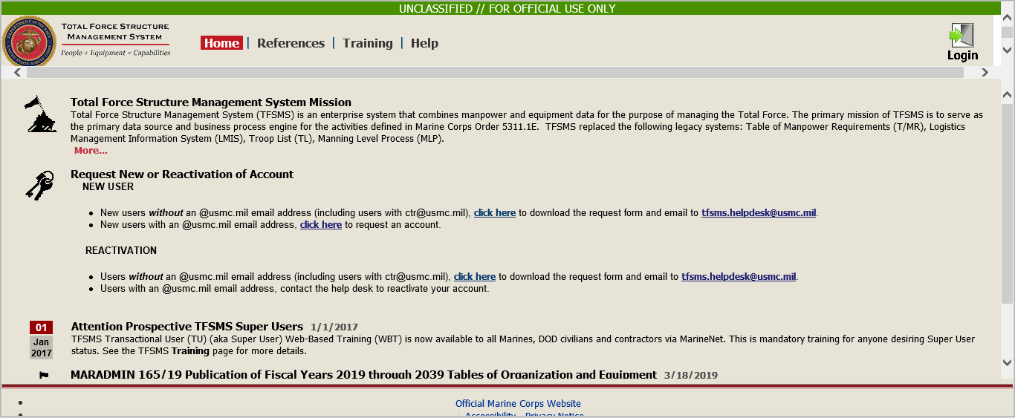

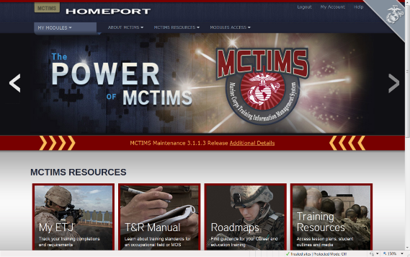
MET Data Alignments within ADS Systems
Personnel Standards / T/O /Critical MOS
AAV BN T/O Critical MOS | MCT 1.1.2 Provide Forces | MCT 1.4.1.1 Conduct Breaching Operations | MCT 1.6.1 Conduct Offensive Operations | MCT 1.6.4 Conduct Defensive Operations | MCT 1.12.1 Conduct Amphibious Operations | MCT 5.3.2 Establish Means for Command and Control
1803 AAV Officer | X | X | X | X | X | X
2141 Amtrac Repair/Tech | X | X | X | X | X | X
2841 Systems Repairer | X | X | X | X | X | X
0621 Field Radio Operator | X | X | X | X | X | X
0651 Cybernet Ops | X |  |  |  |  | X
8404 Corpsman | X | X | X | X | X | X
Equipment Standards / T/E / MEE
MEE TAMCN | NOMEN-CLATURE | MCT 1.1.2 Provide Forces | MCT 1.4.1.1 Conduct Breaching Operations | MCT 1.6.1 Conduct Offensive Operations | MCT 1.6.4 Conduct Defensive Operations | MCT 1.12.1 Conduct Amphibious Operations | MCT 5.3.2 Establish Means to Command and Control
B1315 | Launcher, MK-154, MOD 1 |  | x
E0796 | AAV, C4, AAVC7A1 | x |  |  |  |  | x
E0846 | AAV, Personnel, AAVP7A1 | x | x | x | x | x | x
E0856 | AAV, Recovery, AAVR7A1 | x
Training Standards
TRAINING EVENTS | MCT 1.1.2 Provide Forces | MCT 1.4.1.1 Conduct Breaching Operations | MCT 1.6.1 Conduct Offensive Operations | MCT 1.6.4 Conduct Defensive Operations | MCT 1.12.1 Conduct Amphibious Operations | MCT 5.3.2 Establish Means to Command and Control
AAV-CSS-7002 Conduct Recovery and Evacuation Operations |  | X | X | X | X
CIED-OPS-7001 Operate in Environ with an IED Threat |  |  | X | X
AAV-CSS-6001- Employ Combat Trains |  |  | X | X
AAV-CBST-5001 Support a Breach |  | X
Mission Statement and T/O&E should support chosen METs
MET/METL Review process ensures alignments
and data integrity interfaced to DRRS.

Slide 26
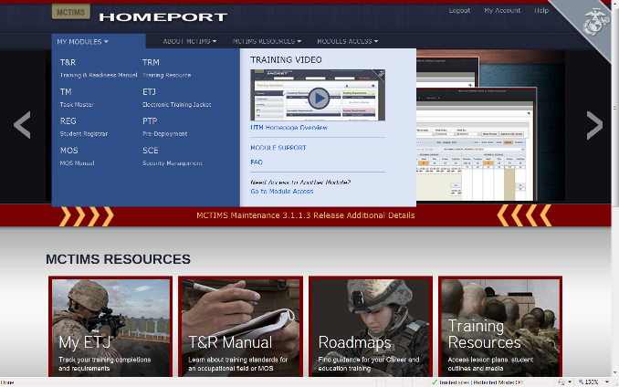
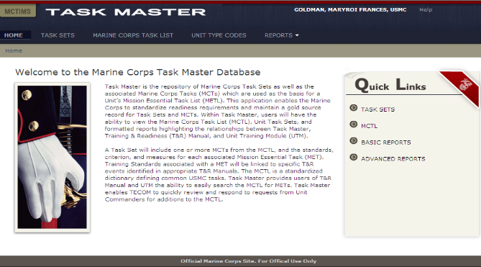
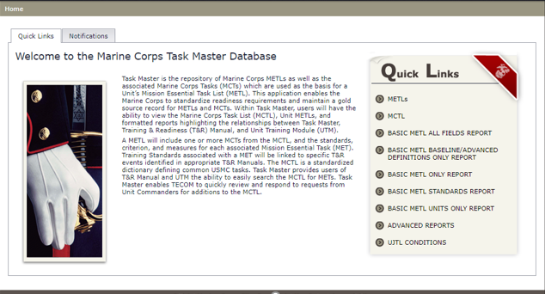
MCTIMS Task Master
ADS for MCTL / METs / METLs
MY MODULES
TM
TASK MASTER
26

Slide 27
MCT / MET / METL Development
Results & Approvals
REVIEW WORKSHOP
CONSIDERATIONS
  Unit capabilities, manned / resourced, supporting current mission requirements.
  “Future” Force Design developed METs are NOT incorporated into current Core METLs but assist TECOM in necessary experimentation, curriculum and training roadmap development.
  MCT/MET changes requires stakeholder coordination across echelons.
  TECOM / CD&I FYXX MARADMIN announces coordinated MET/METL / T&R Manual / TMT Reviews
    Physical or Virtual
    Date and Location
  Reviews are conducted ISO Service priorities
  COIs may request MCT/MET refinement/modification that addresses mission or structure change, resource or training requirements or deficiencies.
PROCESS CONTROL
ENDSTATE
COI Mission Statement should support chosen METs.
Workshop “data-driven” deliverables are staffed via DON / ETMS2 for O6 Level and Principal Advisor approval. GO-Level staffing sometimes required.
Identified capabilities/tasks, w/training aligned to the T&R Manual, and man/equip/output standards, provides a Commander the adequate ability to build a Training Plan and to assess his unit’s METL readiness in DRRS.
Overview of COI METL Review provided to CD&I’s METL Governance Board (MGB) for visibility and approval.
MGB products, with Decision Memoranda for signature by DC CD&I, validating MGB voted decision and MET/METL products.
CD&I/TFSD MCTL Branch facilitates MCT/MET changes within MCTIMS Task Master for immediate use as reportable METs.
FMF MET data is interfaced through MCTIMS to DRRS.
CD&I’s collaborative/coordinated process codified per MCO 3500.110
Notes:
27

Slide 28
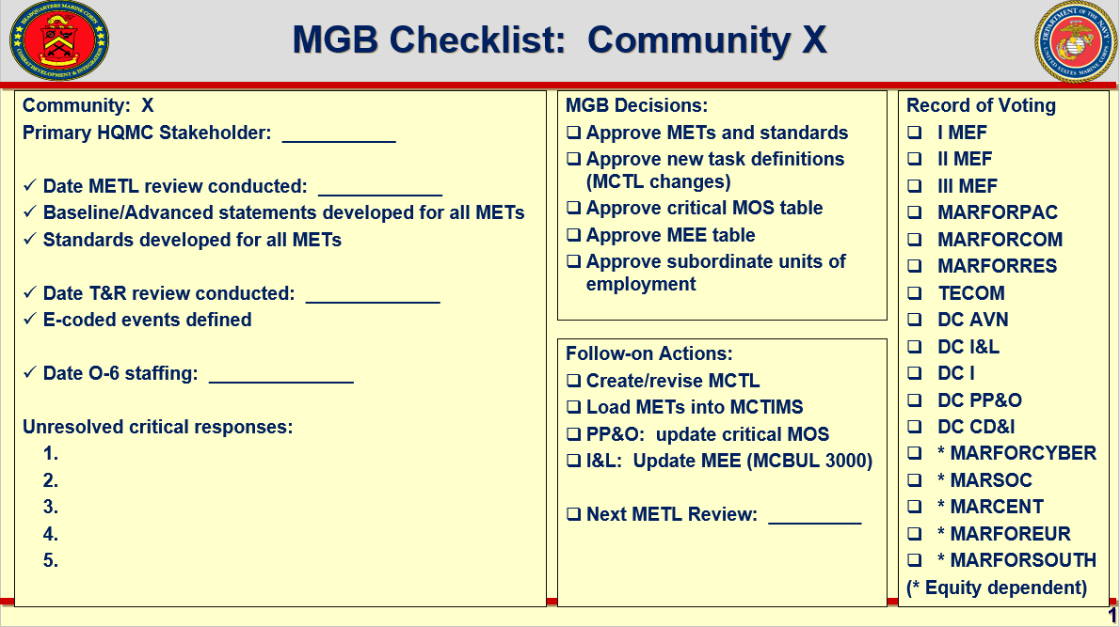
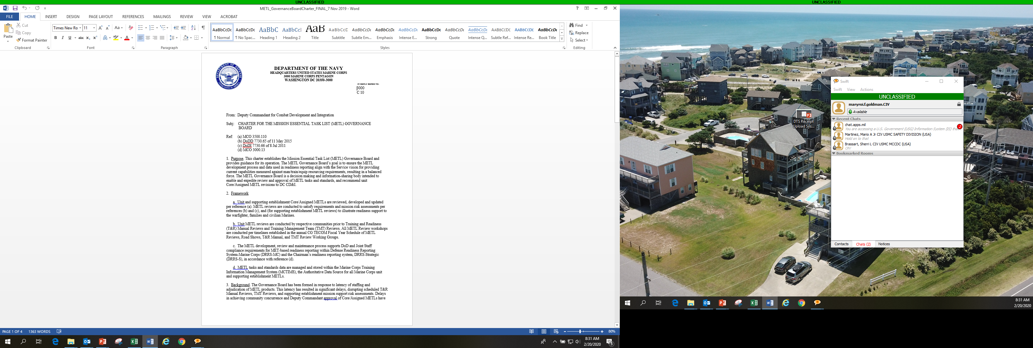
CD&I / CDD / MCID
METL Governance Board
Chartered 2019 by DIRLAUTH DC, CD&I**
**Revision FY24
Adjudicate MET/METL review developed products; comments and recommendations
Capture Decisions and Align Supporting Actions
Decision Memoranda, approved/signed by DC CD&I released via DON-EMTS2
O-6 level reps from HQMC, MARFORs, MEFs, FMF, and SE. Chaired by CD&I/TFSD. Reps assign AOs/SMEs

Slide 29
CD&I’s MCT/MET Life Cycle Supports
GFM RFF Readiness Synchronization
Integrated and Codified Process Policies:
MCO 3000.13 (2020) Readiness Reporting (DRRS) SOP
MCO 3500.110 (2011) MET/METL Development
MCO 3502.6A (2013) Marine Corps Force Generation Process
MCO 3501.1D (2019) Marine Corps Combat Readiness Evaluation (MCCRE)
MCO 1553.10 (2014) Marine Corps Training & Info Mgmt (MCTIMS) SOP
MCO 3120.12 (2015) Global Force Management and Force Synchronization
D-360
1
GFM RFF/RFC - PP&O Mission Review / Apportionment / FMF Sourcing Selection
2
MCTIMS - MET/METL Developed and Governance Board Validated Products
D-180
3
MARFOR Review
PP&O Validation
MCTIMS METL Data Interface to DRRS
Track Readiness Assessments
4
PTP
ITX/MRX
D-30
MARFORs, ISO assigned COCOMs/CCDRs, registers FMF capability and mission resource requirements via RFF / RFC to PP&O.
Approved/Validated MET/METL Review Workshop developed Core METLs and standards entered into MCTIMS and interfaced to DRRS for immediate use by FMF units.
PP&O validates Assigned METLs to requesting MARFORs / MEFs and conducts pre-deployment unit readiness synch per mission requirements.
Necessary PTP / Exercises / Evals / Certification validations and timelines are completed and coordinated.
MCCRE
Certification
D-1
Deployment

Slide 30
DC PP&O’s
Institutional Readiness Working Group (IRWG)
Plans, Policies,
& Operations
Purpose: Forum employing existing USMC processes, to address current/future institutional readiness and provide recommendations for mitigation when imbalances impose Risk-to-Force or Risk-to-Mission.
Endstate: Facilitates a unified approach to informing Senior leaders in the areas of institutional readiness and ensures MC maintains a sustainable “Ready Force” to meet OPLAN demands.
Current Support: Force Synch.Conf, Force Mgmt Summit, Quarterly Readiness (QRB) to the CMC.**
Future Support: Determining predictive and forecasted readiness challenges to satisfy CMC’s prioritized guidance for Future Force Design implementation.
Membership: All DCs, MARFORs, MEFs, LOGCOM, MCICOM, DIRINT, DIR-C4, CG TECOM and MARCORSYSCOM. CDD/COPS & MCID/Plans MCTL Branch Lead AOs.
Method:
Monthly AO, O-6, and ESG-IRWG (1-Star GO) Meetings or SVTC to address issues, actionable items and develop/review/refine information, COAs and mission risk slides for the QRB to the CMC.
Director CDD is 1-Star GO Representative on ESG-IRWG.
**Data presented validates current unit readiness or illustrates shortfalls requiring future force solutions and mitigation strategies with institutional commonality.
MAR 2024-UNCLASSIFIED
30

Slide 31
MCT / MET / METL Development
Improved Coordination Goal: MCWL
Establishment Goal: To adopt an agreed methodology wherein concept development, wargaming and scenario experimentation information conducted by MCWL’s Future Force initiatives is integrated or made visible to the MET/METL and training development processes.
Objective: Would ensure NEW Future Force structure, unit repurposing and/or evolving unit formations factor “current” capability data injects (man/train/equip standards) that the MET/METL/T&R Manual processes develop and maintain.
Doctrine alignments or development considerations necessary to validate future TTPs and academics development.
Concepts, once approved by Senior leadership, could provide source docs (i.e., TMEABO) to aid, guide and inform MCT/MET capability and associated training development.
Mission Statement development, ICW CDD/TFSD and Principal Advisor community stakeholder, aligns to new MCTs/METs.
Identification of required MOSs within new/repurposed formation required to perform future formation METs (i.e., T/O-to-MET)
  Will the new unit formation require MOS recruitment, MOS refinement or repurposing requiring coordination between M&RA and TECOM?
  What training curriculum or Formal School POIs will be required for future force formations?
  Will new unit formations have the necessary materiel, equipment or gear available within an established timeline to ensure adequate training, experimentation, simulation or physical range and field exercises associated to the future formation MET (i.e., T/E-to-MET)?

Slide 32

MCTL Branch Support
MCTL / METL Products:
Marine Corps Training & Information Management System (MCTIMS) Task Master Module:
https://mctims.usmc.mil/TNRManual/TaskMaster/Pages/Home.asp
MARYROI GOLDMAN, CIV-GS14
MCTL Branch Head
Total Force Structure Division
HQMC CD&I / CDD
(703) 784-6085 Maryroi.goldman@usmc.mil
Maryroi.Goldman@usmc.smil.mil
MARIO MARTINEZ, CIV-GS13
MCTL Branch Program Assistant
Total Force Structure Division
HQMC CD&I / CDD
(703) 432-2883
Mario.a.martinez2@usmc.mil
Mario.Martinez@usmc.smil.mil
JAMES E. MARTIN, CIV-GS13
MCTL Branch Program Assistant
Total Force Structure Division
HQMC CD&I / CDD
(703) 784-3363
James.e.martin@usmc.mil
James.e.martin@usmc.smil.mil

Slide 33
BACKUPS

Slide 34
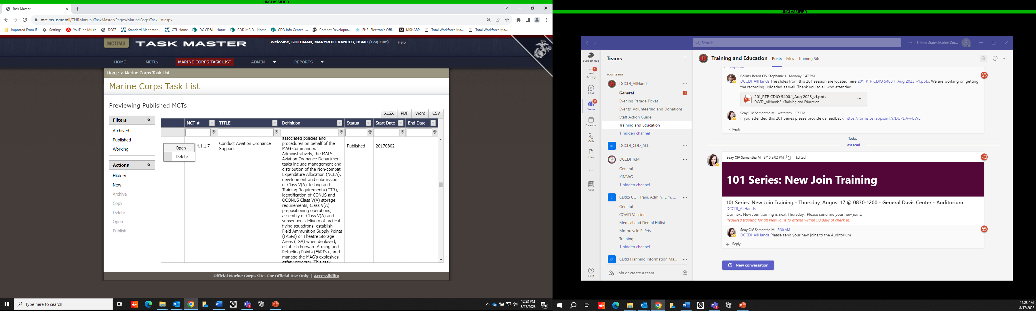
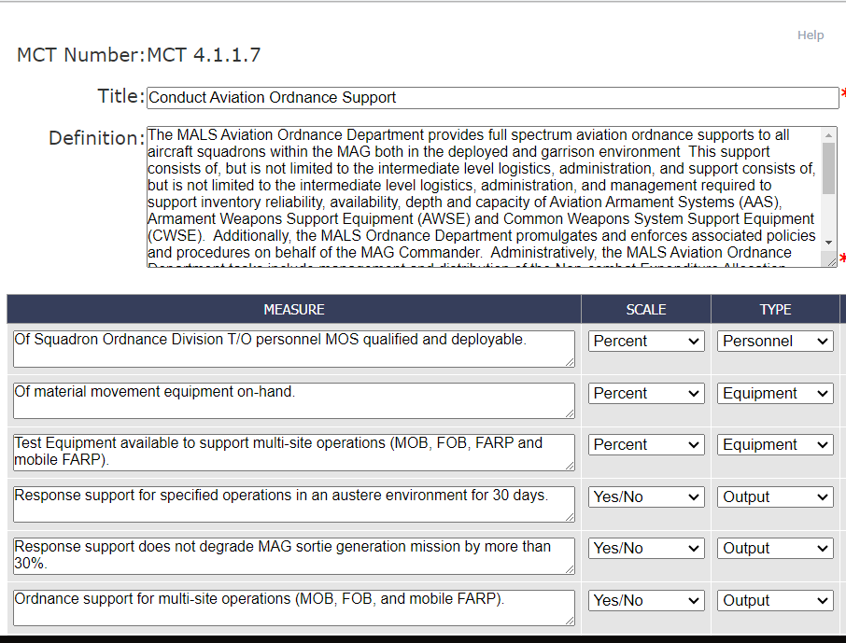
MCTIMS Task Master
Marine Corps Task List

Slide 35
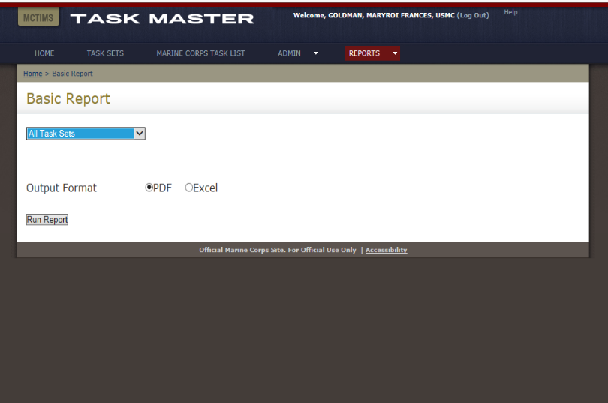
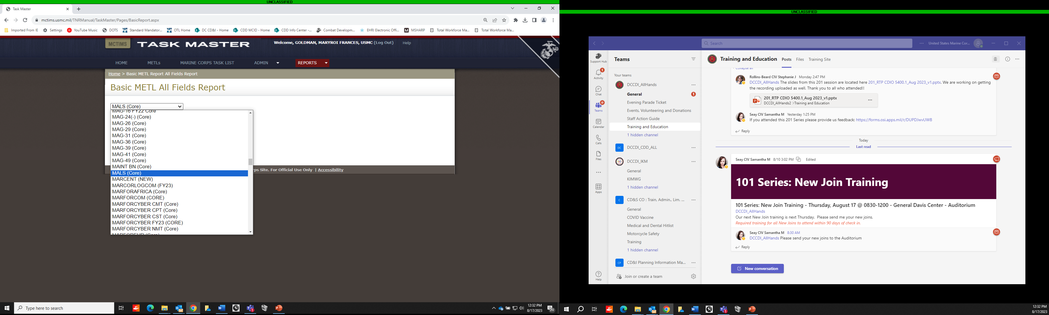
MCTIMS Task Master
Task Sets/METLs / Community Reports

Slide 36
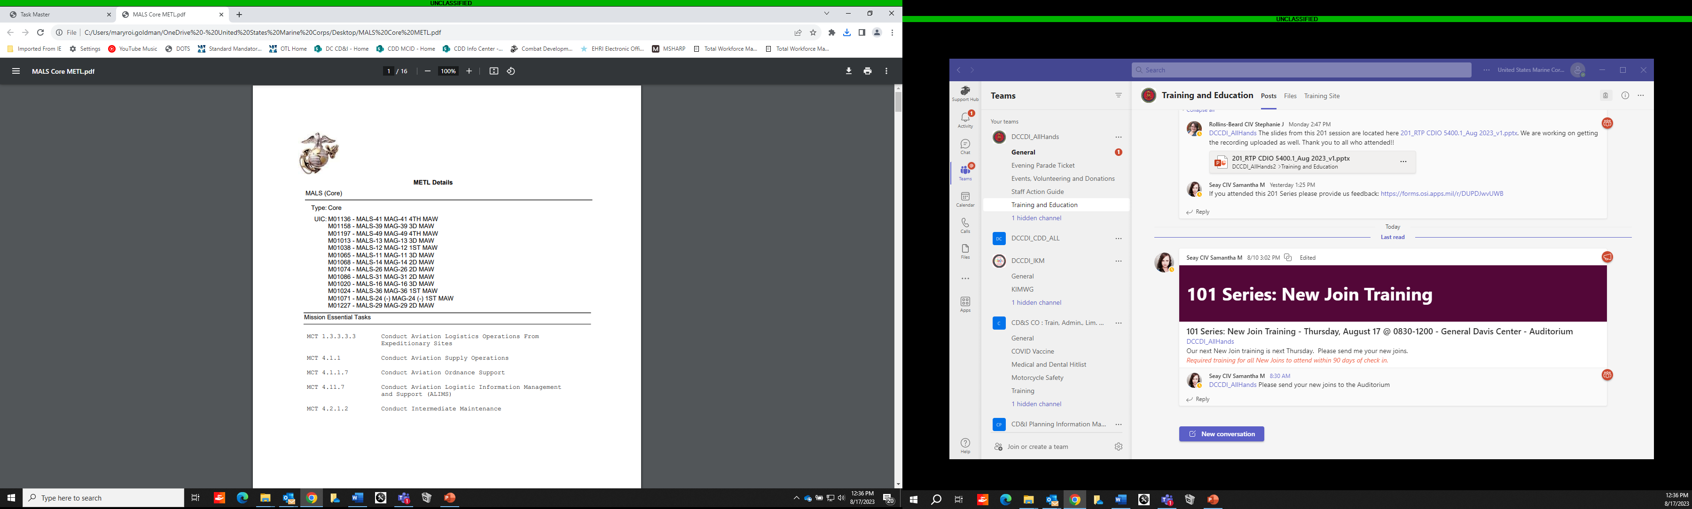

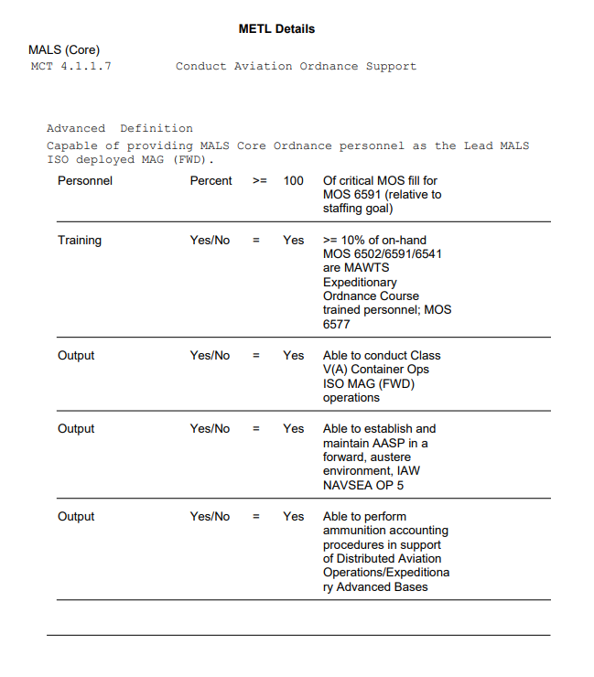
METL Reports
Org UIC / METL / MET Summary:
Baseline/Advanced Capability Statement, Personnel, Equipment, Training and Output

Slide 37
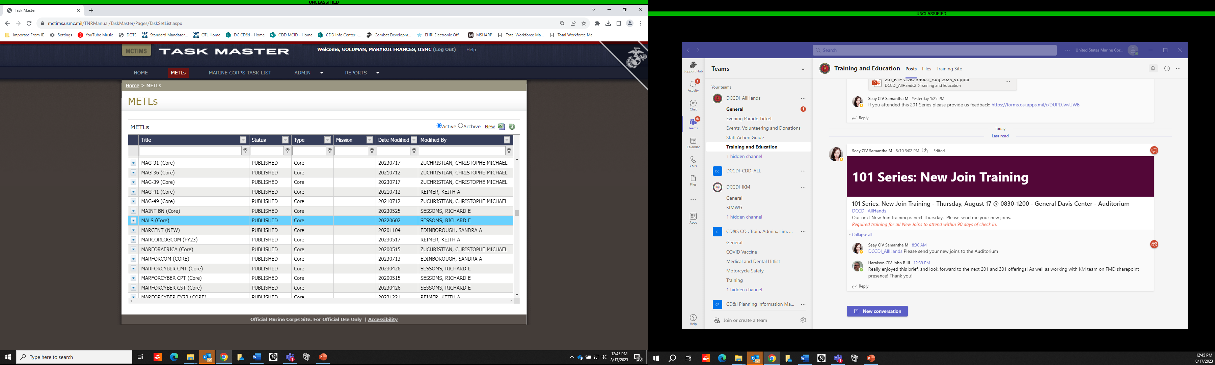
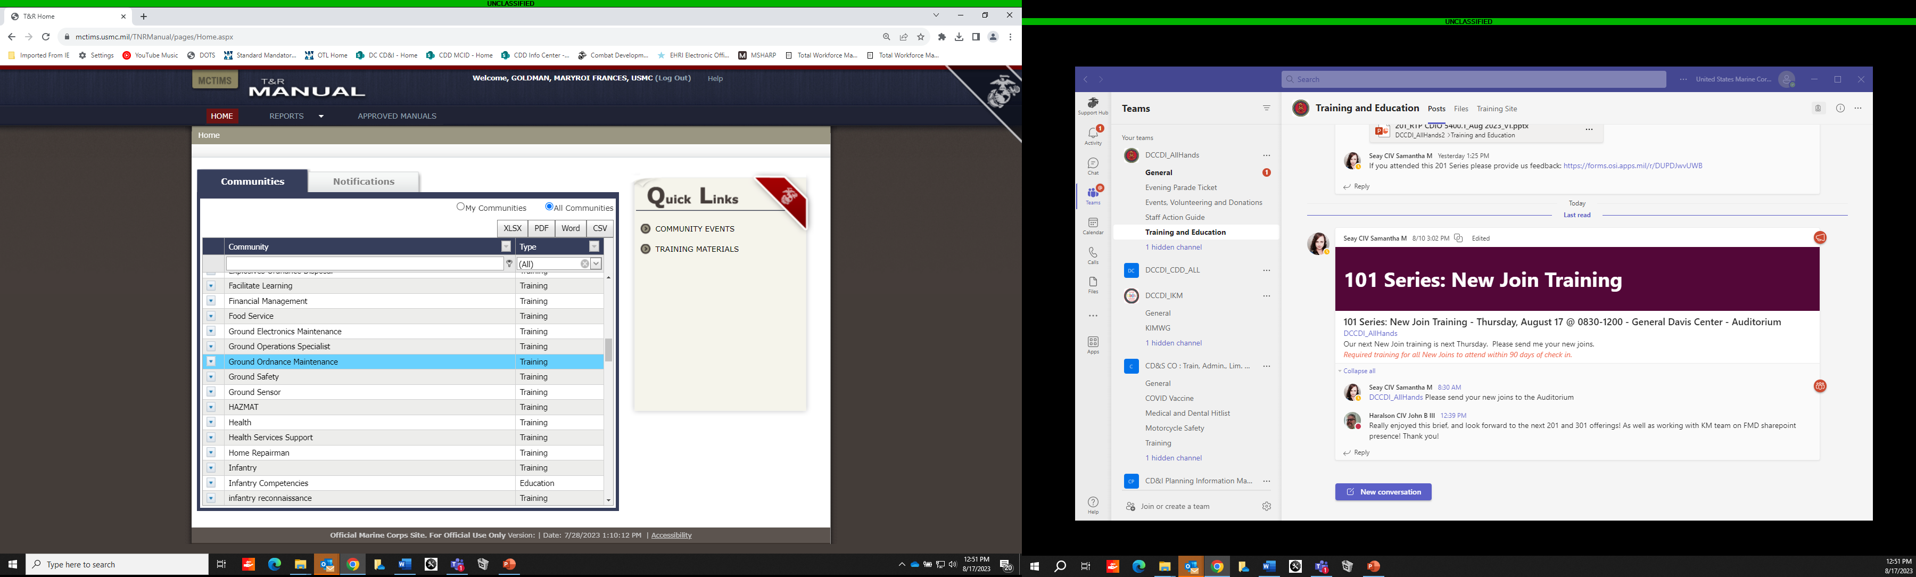
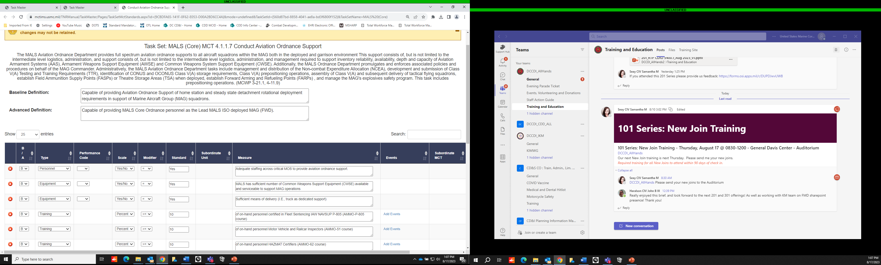
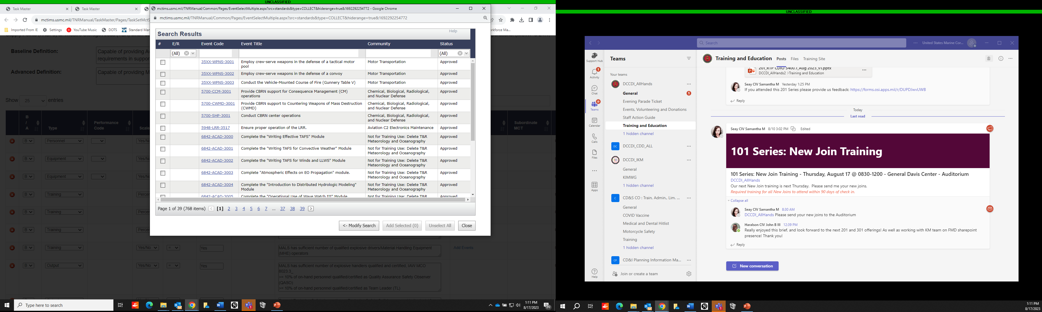
MCTIMS Task Master
Task Sets/METLs, T&R Manual, Community Training Events

Slide 38
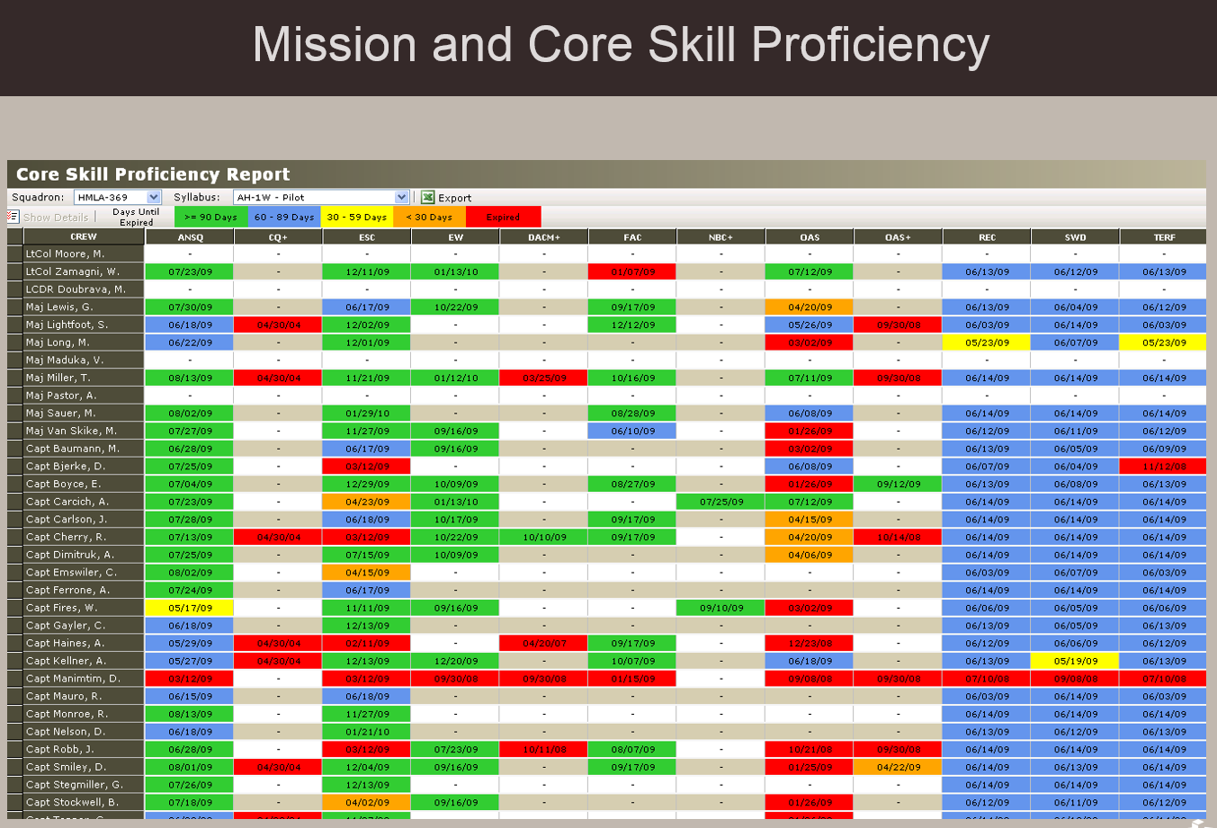
MSHARP
USN/TECOM Aviation Training & Readiness System
MSHARP Modules:
Flight Logger
Aircrew Logbook
Individual Qualifications (Admin)
Individual Qualifications (Flight)
Individual Event Proficiencies
METs/Mission and Core Skill Proficiency
SBTP / Formation
Simulator Management
Simulator Scheduling
Simulator Utilization
Unit Flight Scheduling
Resource Availability
Sortie Based Training/Flight Hour Program
Flt Leadership
TMR Codes
T&R Codes
Approaches
Landings
Ranges
Ordnance
FAC(A) Controls
Passengers / Cargo
Hoist / Fuel Reports

Slide 39
Critical MOS – DRRS P Levels
DRRS calculates the P-Level of a reporting unit based on the lower of two levels:
  The overall personnel strength based on T/O. For this calculation to yield a Personnel Strength of P-2, the unit must have 80% of personnel available (not detached) and deployable.
  The critical MOS fill, based on selected MOS. A script will look for BMOS and PMOS matches for each BIC on the T/O, generating a requirement for each selected MOS. The total fills (available/deployable) against these requirements, divided by the total requirements, yields a percentage. For this calculation to yield a P-2, the unit must have 75%. At least three MOS must be designated.
If every MOS is critical, the two calculated percentages will be equal, and the critical MOS will never be a factor because 80% is a tougher requirement than 75%. We try to avoid the added work of reporting critical MOS when doing so does not improve value of the report.
If the critical MOS list includes a high volume MOS as well as several lower density MOS, the lower density MOS will not matter.
  Example: A unit could select a High Density MOS (30 x 0311), as well as two lower density MOS (1x 0302 and 1x0369).
  If the 30 x 0311 are filled, the unit could be 30 of 32 (94%) even if neither of the other two are filled.
  An excess in 0311 (32 of 30 x 0311 billets filled), can put the unit at 100% critical MOS fill with the other critical MOS entirely gapped.
No automatic requirement to designate the "identity" MOS for a unit as critical. No requirement to designate 0311 Infantrymen for an Infantry Battalion. [Strongly discouraged for reasons noted above.]
As a result, two best practices apply:
  1) Do NOT select a set of critical MOS that in total would represent over 50% of the unit.
  2) Do NOT select any critical MOS that represents a high volume in comparison to the other selected MOS.
Exceptions:
  1) Some units only have 3 MOS. In this case, they must select all 3.
  2) Some units have a higher density MOS with a historically low level of fill - a new MOS, a problem MOS, etc., and other MOS don't matter or are not expected to be an issue. In this case it may be worth selecting the MOS in order to focus on the main issue.
BLUF: Wherever possible, use the Critical MOS list to highlight low density MOS that would be lost in the aggregate calculation but generate disproportionate effects if not filled.

